Slide 1
TASK 14
Final Presentation
09. June 2015
Team Green: MR, NM, RZ, SB, TS

Slide 2
Agenda
Demo of prototype
Contribution of each team member
Lessons Learned

Slide 3
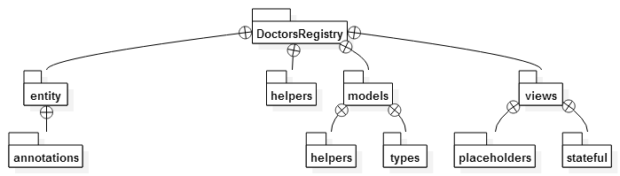
Package Overview

Slide 4
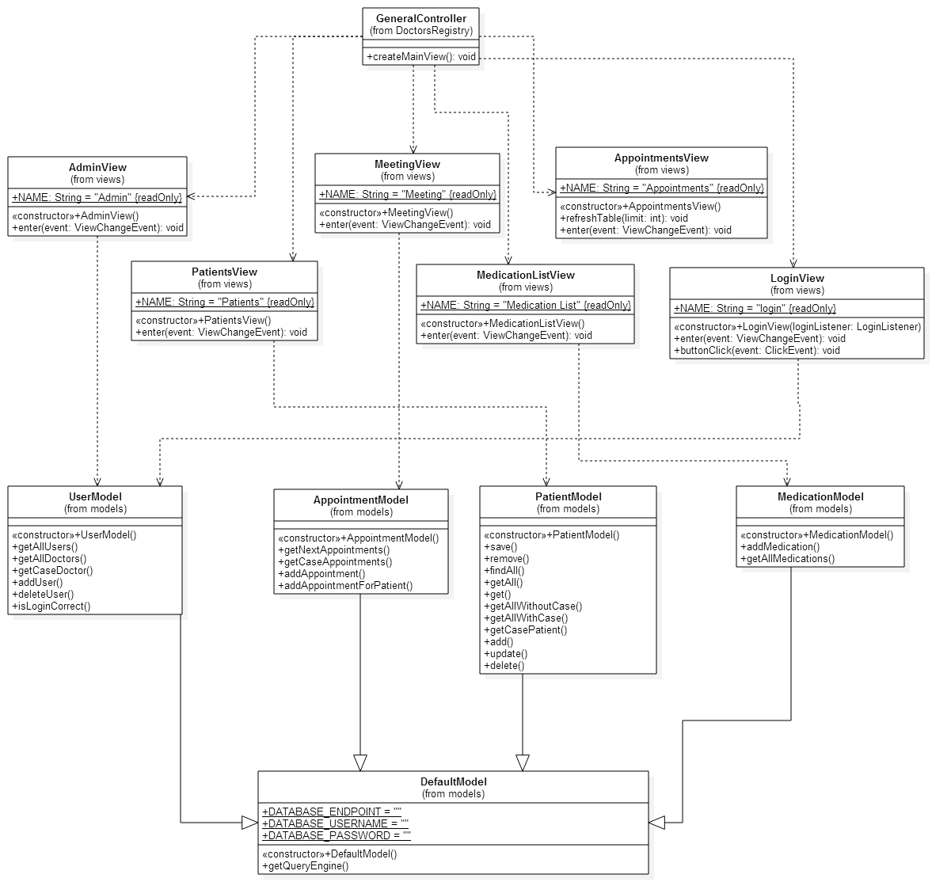
Class Diagram

Slide 5
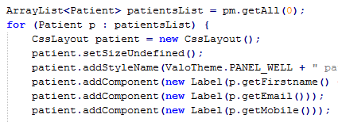
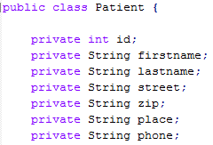
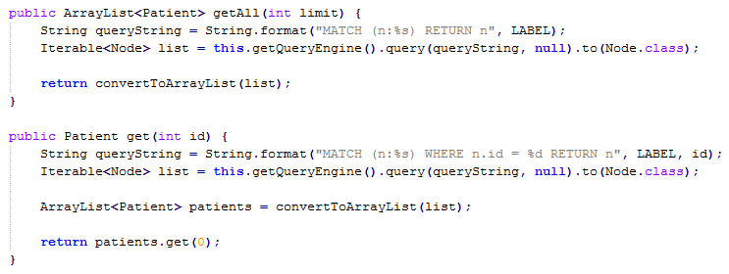
Patients (Michael)
Views
PatientView
PatientDataView
PatientForm
Model (DB connection)
PatientModel
Entity
Patient

Slide 6
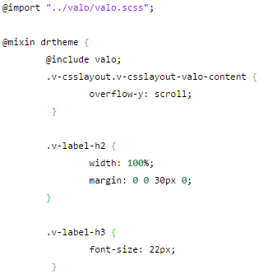
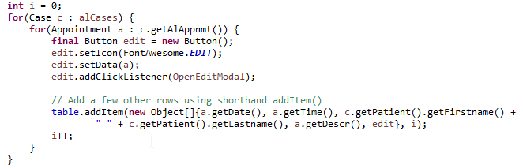
Appointments (Tobias)
Views
Global Improvments
Standardize
CSS Fixes
Appointments

Slide 7
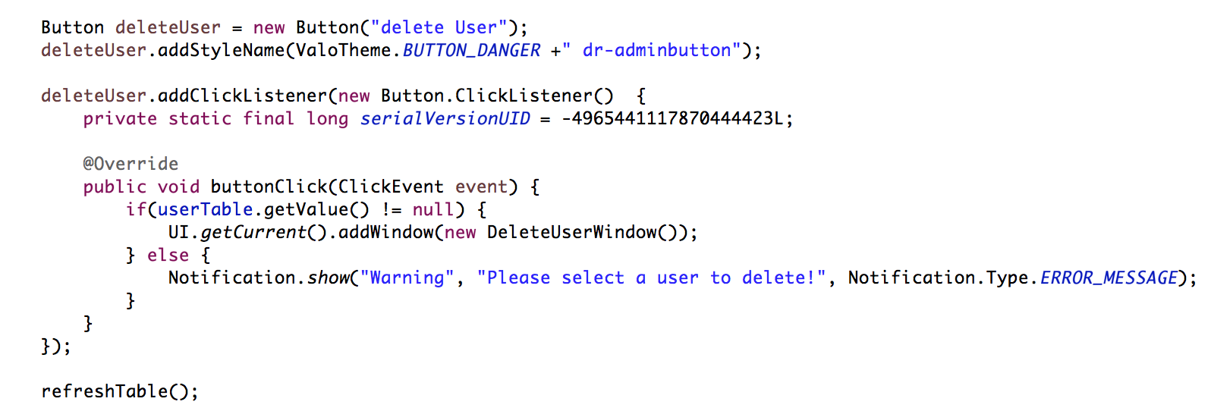
Admin View (Reto)
delete Button
CSS-Styles
ClickListener
Check if user is selected
If not show nice warning Notification

Slide 8
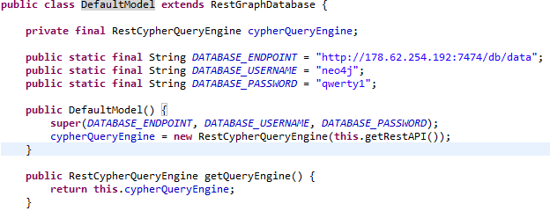
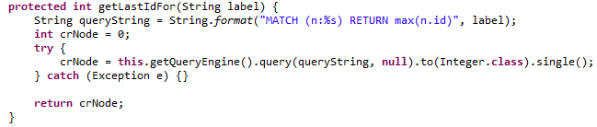
Default Model (Sergii)
Establishes a connection to DB (neo4j)
Triggers default queries using RestGraphDatabase

Slide 9
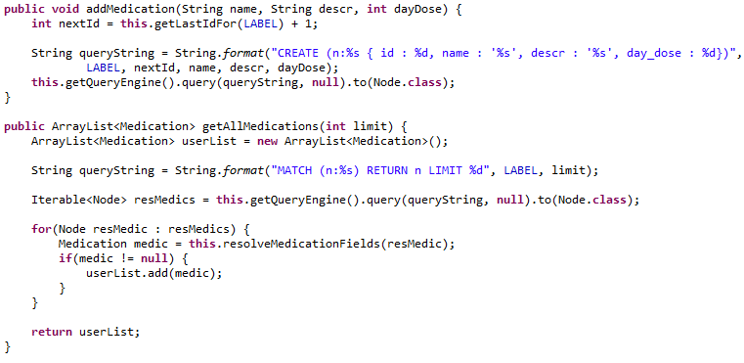
Medication Models (Sergii)
Added Medication View and Model
Dose control is implemented over amount of mg per day

Slide 10
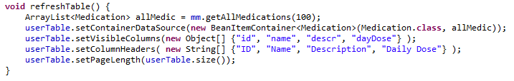
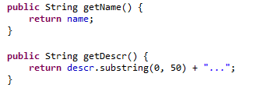
Medication Views (Sergii)
Used BeanItemContainer
Makes search on getters

Slide 11
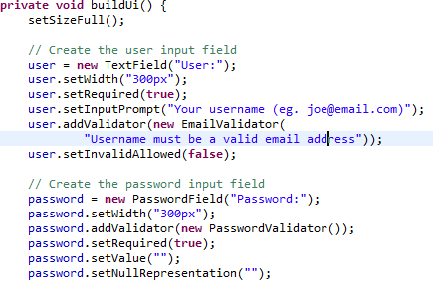
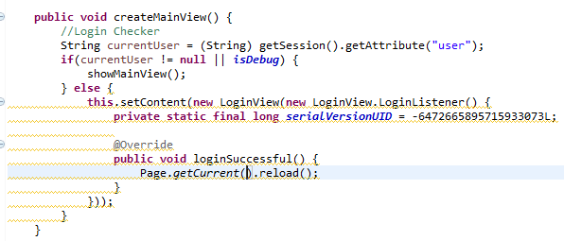
(Nalet) Login & Admin Model
LoginView
Login Logic
Entity:User; AdminModel;

Slide 12
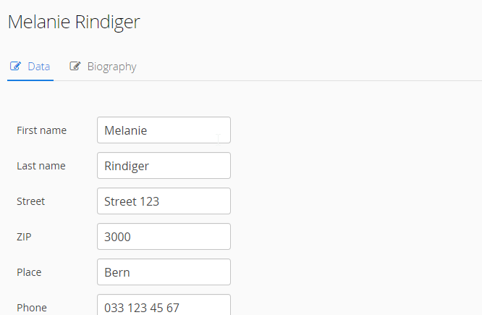
Demo of prototype

Slide 13
Lessons Learned
Scrum
Tasks should be better distributed
Member A should not be dependent of member B
Communication with customer give a chance to adjust the application logic
Team collaboration is important in order to distibute tasks and efficiently solve issues
Development
Implemented the Vaadin app using MVP pattern
Successfully applied Vaadin developer experience
Successfully used Git
Not everyone understands the concepts
Used neo4j graph database to keep app data
Implemented client-server application

Slide 14
Questions?

